Slide 1
Vide Coding and Beyond: Coding Less, Thinking More
41129-Software Innovation Studio (SIS) 2025
Dr. YK Wang , Ziyi Zhao, Connor Barkley, Justin Sia

Slide 2
Agenda
W5: Getting Started
Make sure every student gain a basic understanding of vibe-coding concepts and have access to vide coding tools (cursor&replit).
W6: Fixed Project, Step-by-Step, testing and deployment
Build one complete, working project together so they understand the workflow from start to finish.
Teach them how to verify the project works and share it publicly.
Each:～30mins

Slide 3


W5: Getting Started
1.Intro & Motivation (2–3 min)
Why we’re using Vibe Coding
What they will be able to do by the end of the 2 sessions
2.Access & Setup (8–10 min)
Log into Cursor Student Account
Overview of the interface (editor, file explorer, run, preview)
Make sure all accounts work before next session
3.General Knowledge (8–10 min)
Basic coding concepts
Example: run a provided “Hello World” or animated demo

Slide 4
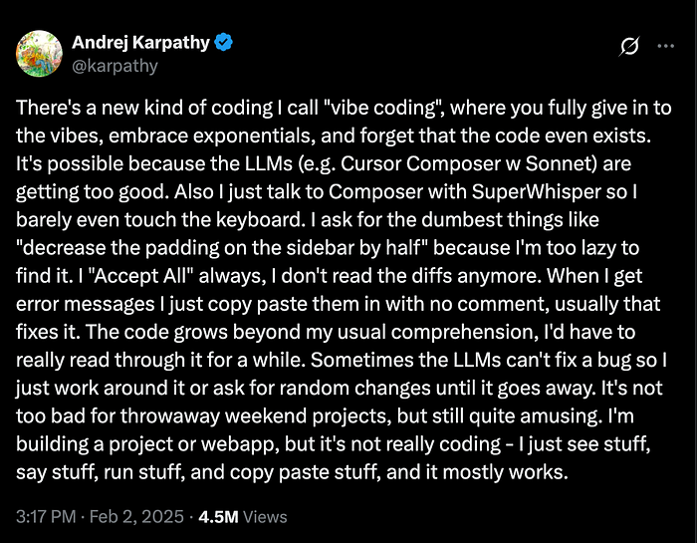
What did
Vide Coding
unlock
for you?
Notes:
Warm-up by posting a question: what is vide coding, does anyone know?
Vide coding: This is a relatively new concept — it is not a traditional programming language or framework, but rather a relaxed, vibe-driven approach to coding.”
* Immersive: Share any experience with vibe coding//

Slide 5





OpenAI
Anthropic
AI
SDK
Llama
Nova
Notes:
Tools, platforms + AI software development kit = apps

Slide 6
Vibe Coding today
Large jump in productivity
Can take you from “idea to app”
Limited by “developer experience”
Has its “gotchas”

Slide 7
5 Skills in Vibe Coding
Thinking, Frameworks,Checkpoints,
Debugging, Context

Slide 8
Thinking
Logical： What is the game?
Analytical： How do I play the game?
Computational： What are the patterns behind the game?
Procedural： How do I excel at the game?

Slide 9
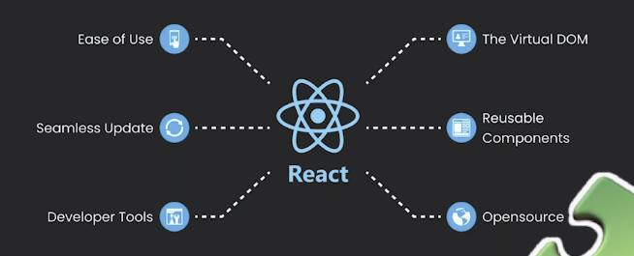
Frameworks
You don’t know what you don’t know
How do I do the thing I want to?
What frameworks
…allow me to do that thing?
…work best with LLMs?
If you don’t know… just ask!

Slide 10
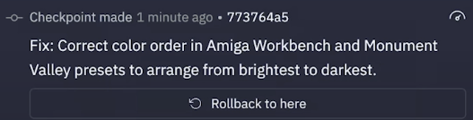
Checkpoints / versions
Things break — this is a fact
You should use version control (checkpoints, git…) to minimize this
We’ll chunk up our builds and move quickly in short sprints

Slide 11
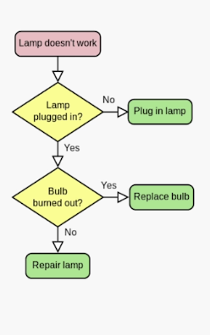
Debugging
It’s actually a bit boring
○ But you can make anything fun!
○ The best debugging is methodical and thorough
Goals:
○ Understand how your app works
○ Understand where the error is
How can you get to the root?
How can you tell the LLM what’s wrong?

Slide 12
Context
What do we mean when we say “context?”
Context window: the amount of tokens an LLM can process at a given time.
Context can be the prompt we provide to the LLM, but it can also be other things:
Images
Documentation
Errors
Details about your app / environment / preferences (!)
Because LLMs might have outdated training data (or lack details of our implementation), we need to provide additional context.

Slide 13
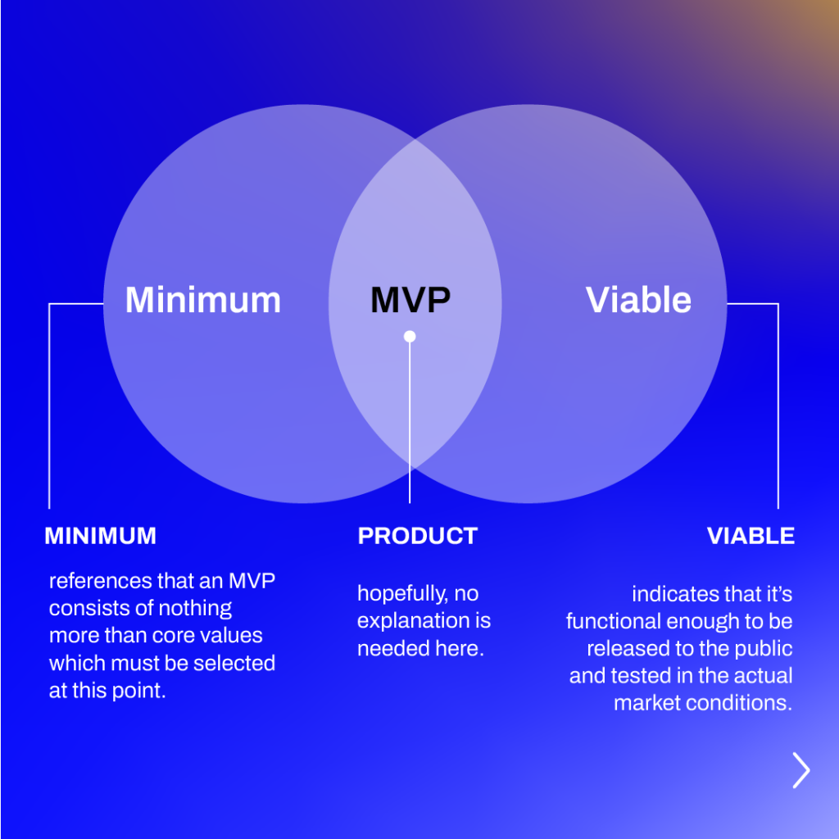
Getting to a MVP
Give AI only the information relevant to the MVP
Start small and work up
Provide foundational context and important details
Reference: What is a minimum viable product (MVP)? By Atlassian

Slide 14
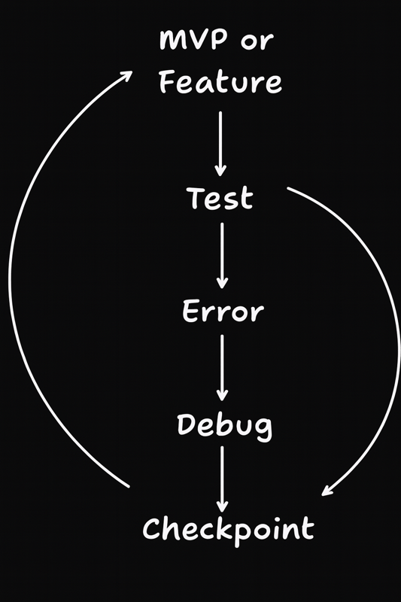
Implementing new features
Provide context relevant to the new feature
Mention frameworks, provide documentation with EXPLICIT details on implementation
Make incremental changes (checkpoint)
Debugging errors
Figure out how things work
Figure out what’s wrong
Figure out how to get information to the LLM to get unstuck
Figure out how to direct context

Slide 15
Future Outlook
Coding Focus
Developers primarily engaged in writing code while beginning to integrate early AI tools for support.
AI Partnership
Future developers will collaborate seamlessly with AI, emphasising learning and flexibility in their roles.
2020s
2030s
Code less. Think more.

Slide 16
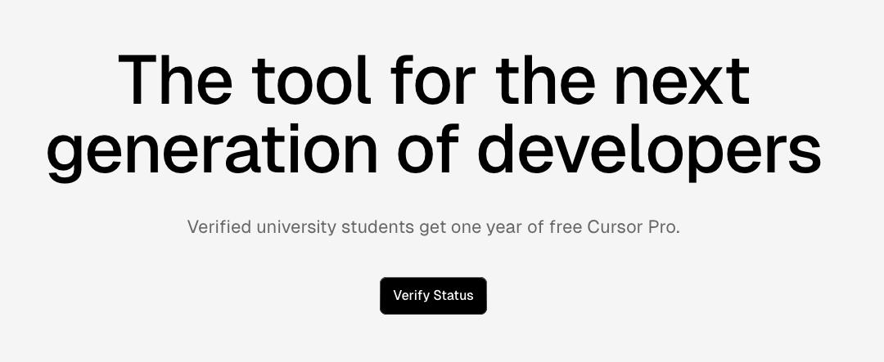
Cursor for Students
https://cursor.com/home
https://services.sheerid.com/verify/681044b7729fba7beccd3565/?userId=user_01JXWC964SAW1ZJX026208D1BT

Slide 17
Resources
Vibe Coding 101 with Replit: https://learn.deeplearning.ai/courses/vibe-coding-101-with-replit/lesson/rmlc7/principles-of-agentic-code-development
Claude Code: A Highly Agentic Coding Assistant: https://www.deeplearning.ai/short-courses/claude-code-a-highly-agentic-coding-assistant/
A Comprehensive Guide to Vibe Coding Tools: https://medium.com/madhukarkumar/a-comprehensive-guide-to-vibe-coding-tools-2bd35e2d7b4f
Andrej Karpathy
https://karpathy.ai/
https://www.youtube.com/andrejkarpathy

